Slide 1
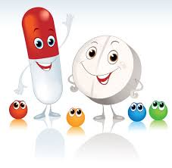
The Effect of Acetaminophen on Music, Speech, and Natural Sounds Lindsay A. Warrenburg Ohio State University
Notes:
When you think of Tylenol, what do you think of? I think most people think of reducing fever, alleviating a headache, or helping to ease muscle pain. In my presentation today I will talk about another potential effect of Tylenol – that of blunting emotional responses to sounds.

Slide 2


Background
20% of all adults in the United States consume acetaminophen at least once a week (Kaufman et al., 2002)
Typical Use: reduces physical pain
Unexpected Use: reduces social pain and empathy
Notes:
The active ingredient in Tylenol is acetaminophen (or paracetamol for those from Europe). 20% of all adults in the US consume acetaminophen at least once a week. That’s about 50 million Americans. The typical use of acetaminophen is to reduce fever and physical pain. However, an unexpected effect of acetaminophen is that it reduces social pain and empathy.

Slide 3


Background
Participants who ingested acetaminophen made attenuated emotional judgments of pleasant and unpleasant pictures from the International Affective Picture System (Durso, Luttrell, & Way, 2015)
Notes:
In a series of studies, Baldwin Way and colleagues have discovered that Tylenol can make you less empathic to others and that Tylenol can blunt your emotional responses to picture stimuli. They found that participants who ingested acetaminophen made attenuated emotional judgments of pleasant and unpleasant pictures from the IAPS.

Slide 4
Background
Perceived emotion blunting
Induced emotion blunting
Notes:
In these studies, the participants both PERCEIVED less emotion in the pictures – so they found a happy picture as being less happy – and EXPERIENCED less emotion from the pictures – so they felt less disgust from a disgusting picture.

Slide 5

Study Aim
Do the emotional blunting effects of acetaminophen extend to the auditory and musical domains?
Notes:
The aim of my study was to test whether the emotional blunting effects of acetaminophen extend to the auditory and musical domains. I replicated Dr. Way’s study, using sound stimuli instead of picture stimuli.

Slide 6



Three Kinds of Sound
(1) Natural Sounds
(2) Speech
(3) Music
Notes:
Generally speaking, there are three kinds of sound: Natural sounds (like waves on a beach), speech, and music. In my study, I used all three of these types of sound.

Slide 7
Emotion in Music
Perceived Emotion How listeners recognize emotions in music
Induced Emotion How listeners feel or experience emotions in music
Compared to a placebo, does acetaminophen blunt both perceived and induced emotion?
Notes:
In addition to testing whether acetaminophen blunts emotional responses to different kinds of sound, I was also interested in testing whether acetaminophen blunts both perceived AND induced emotion.

Slide 8
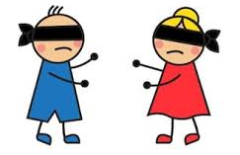
Design
Randomized
Double-blind
Parallel-group
Placebo-controlled
Notes:
I used a randomized, double-blind, parallel-group, placebo-controlled design.

Slide 9
Pharmacological Procedure
Pill containing either 1000 mg of acetaminophen (a normal over-the-counter dosage) or a similar-tasting placebo
After consuming the pill, participants were asked to wait ~45 minutes for the drug to take effect
When the study was over, participants were asked to guess whether they had been given the drug or the placebo
Notes:
Participants ingested a pill containing either 1000mg of acetaminophen or a similar-tasting placebo. After consuming the pill, participants were asked to wait about 45 minutes for the drug to take effect. When the study was over, participants were asked to guess whether they had been given the drug or the placebo.

Slide 10
Experimental Conditions
2 blocks of trial (counterbalanced):
(1) Perceived emotion
(2) Induced emotion
Examples of Uptake Period Questions:
Current affect (PANAS)
Musical sophistication (Ollen Musical Sophistication Index)
Trait Empathy (IRI)
Height and Weight
Other drugs they have taken (prescribed or recreational)
Notes:
The study consisted of two blocks of trial: one for perceived emotion and one for induced emotion. These blocks were counterbalanced across participants. During the drug uptake period, participants completed a number of questionnaires relating to their musical experience, current mood, personality traits, socio-economic status, height and weight, other drugs they may have taken, and so on.

Slide 11

Perceived Emotion
Natural Sounds: 6 second sounds (International Affective Digital Sounds)
Speech: 2-5 second content-neutral sentences (Crowd-Sourced Emotional Multimodal Actors Dataset)
Music Excerpts: 10-15 second film soundtracks clips (Eerola & Vuoskoski, 2011)
Notes:
The goal of the perceived emotion block was to judge the extent to which a sound conveys a certain affect. For the natural sounds stimuli, I used clips from the International Affective Digital Sounds (IADS). For speech stimuli, I used the Crowd-Sourced Emotional Multimodal Actors Dataset (CREMA-D). And for music stimuli, I used excerpts from film soundtracks, curated by Eerola & Vuoskoski (2011).

Slide 12
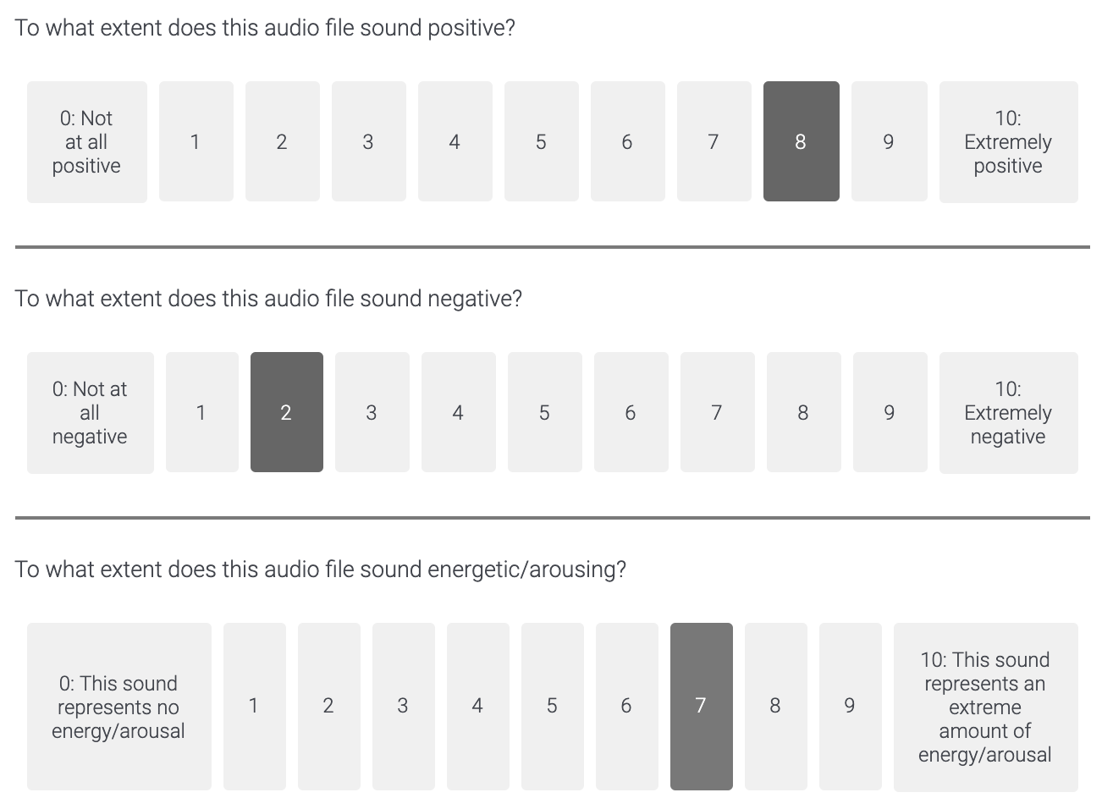
Perceived Emotion
Notes:
In order to assess the valence of the perceived emotion in the stimuli, I asked
“To what extent does this audio file sound positive?” and “To what extent does this audio file sound negative?’
In order to assess the arousal of the perceived emotion in the stimuli, I asked
“To what extent does this audio file sound energetic/arousing?”
All three questions utilized an 11-point Likert scale.

Slide 13
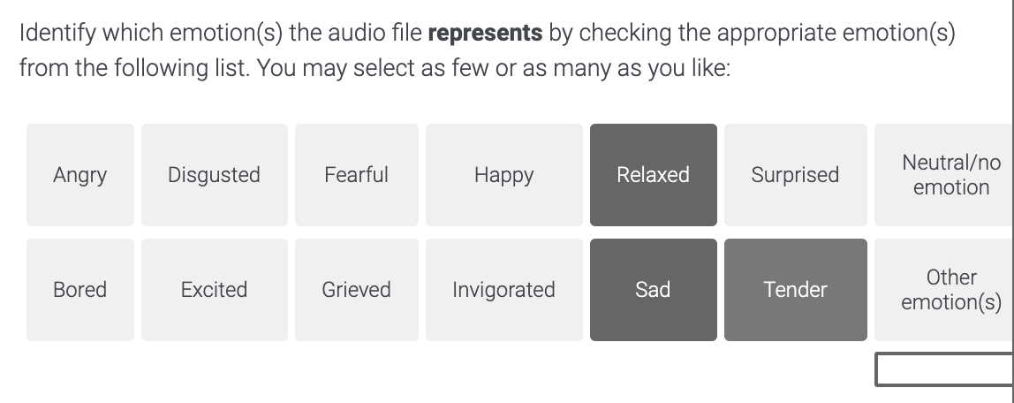

Perceived Emotion
Notes:
I also asked participants to identify which emotions the audio file represents by checking the appropriate emotions from a list. Participants could select as many or as few emotions as they liked. Once they chose the list of emotion terms, they were asked to choose which emotions (if any) strongly apply to the music. By asking participants to choose emotion terms that strongly apply, a three-level response gradient is available for analysis (i.e. does not apply, applies, strongly applies).

Slide 14
Induced Emotion
Natural Sounds: 6 second sounds (International Affective Digital Sounds)
Music Excerpts: 30-60 second film soundtracks clips (Eerola & Vuoskoski, 2011)
No Speech Excerpts
Notes:
In the section on induced emotion, the stimuli were taken from the same databases as before. The stimuli were different from the ones in the Perceived Emotion section. No speech samples were used because the database instructions explicitly state that they should be used only in studies regarding perceived emotion.

Slide 15
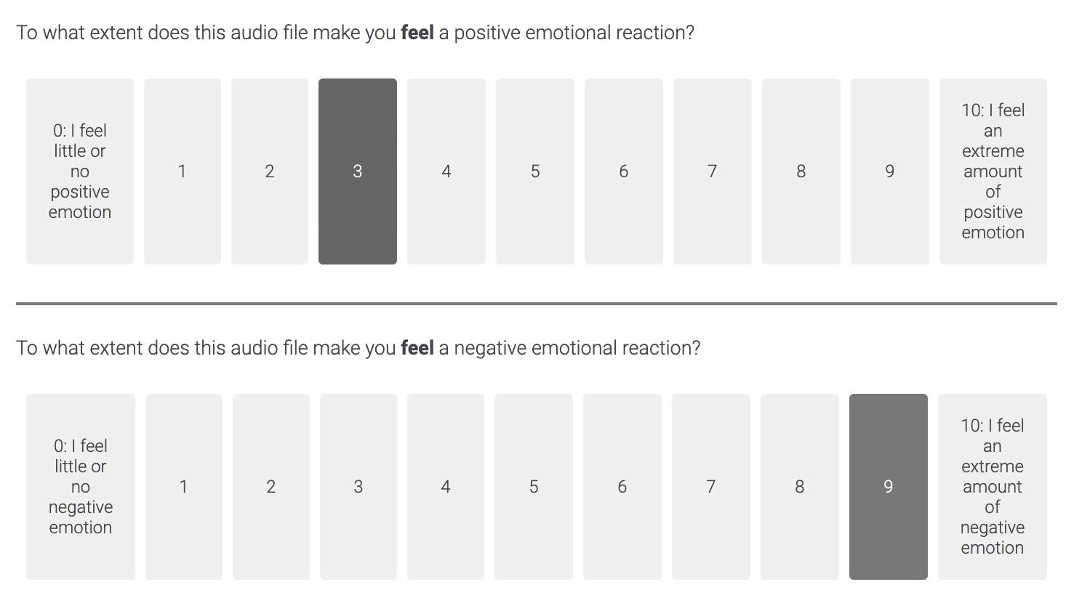
Induced Emotion
Notes:
Participants were asked
“To what extent does this audio file make you feel a positive emotional reaction?” (on an 11-point Likert scale)
“To what extent does this audio file make you feel a negative emotional reaction?” (on an 11-point Likert scale)

Slide 16
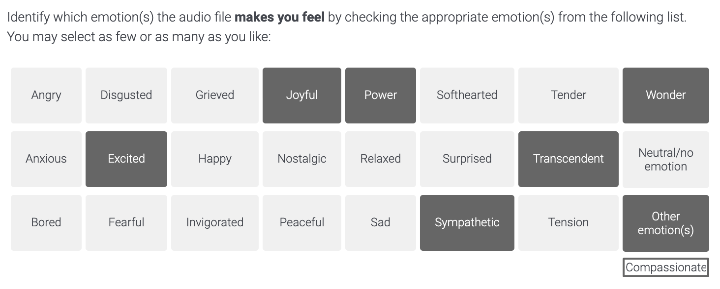
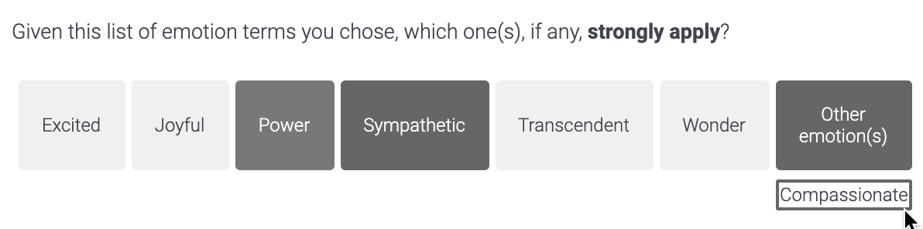
Induced Emotion
Notes:
Once again, participants were asked to identify which emotions the audio file makes them feel by checking the appropriate emotions from a list. They were also asked to choose which emotions strongly apply.

Slide 17
Results
n = 244
Power analysis indicated 200 participants are needed to show a reliable effect (if it is there)
Stimuli fit within their a priori Affect Grid categories
Notes:
244 participants took part in the experiment. A power analysis indicated that 200 participants are needed in order to show a reliable effect, if it is there.
First, I tested the validity of the stimuli. Namely, I tested whether a happy song tended to be perceived as happy, or that angry speech was perceived as angry. I found that the stimuli all behaved as predicted.

Slide 18
Results: Perceived Emotion
The drug condition resulted in lower ratings of positive and negative emotions (both ps < 0.05)
There was no difference in arousal ratings between drug and placebo conditions
 | Positive Emotions | Negative Emotions | Arousal
Placebo | 3.94 | 3.86 | 4.40
Acetaminophen | 3.60 | 3.65 | 4.33
Notes:
The results were consistent with the hypothesis that, compared to a placebo, acetaminophen blunts people’s perception of positive and negative emotions in sound stimuli. For example, on average, those who took a placebo rated emotional sounds as representing positive emotions at an intensity of 3.99 (out of 10), whereas those who took acetaminophen rated an intensity of positive emotions of 3.58.
There was no difference in arousal ratings between drug and placebo conditions.
Perceived Emotion Overall Means -- Positive
Drug 3.60
Placebo 3.94
t = 4.33
p = 0.0
Perceived Emotion Overall Means -- Negative
Drug 3.65
Placebo 3.86
t = 2.85
p = 0.0
Perceived Emotion Overall Means -- Arousal
Drug 4.33
Placebo 4.40
t = 1.06
p = 0.29

Slide 19
Results: Perceived Emotion
Notes:
Post-hoc analyses showed that the blunting effect of acetaminophen was similar across ratings of positive and negative emotions. Acetaminophen attenuated the perception of emotion similarly in music, natural sounds, and speech stimuli.

Slide 20
Results: Perceived Emotion
Notes:
I found that the blunting effect of acetaminophen was similar across neutral stimuli, and stimuli with negative valence and high arousal, negative valence and low arousal, positive valence and high arousal, and positive valence and low arousal.

Slide 21
Results: Induced Emotion
There was no difference in experienced positive or negative emotions between drug and placebo conditions
 | Positive Emotions | Negative Emotions
Placebo | 3.74 | 3.56
Acetaminophen | 3.64 | 3.64
Notes:
Unlike the findings in the study regarding picture stimuli, there was no difference in the intensity of positive or negative emotions experienced by listeners in the drug and placebo conditions.
Induced Emotion Overall Means -- Positive
Drug 3.64
Placebo 3.74
t = 0.74
p = 0.46
Induced Emotion Overall Means -- Negative
Drug 3.64
Placebo 3.56
t = -0.78
p = 0.43

Slide 22
Regression
Predicted Emotion Ratings, where higher numbers represent more intensely felt/perceived emotion
R² = 0.30
Notes:
I used a simple regression model to predict the intensity of the emotion ratings, where higher numbers represent more intensely felt or perceived emotion.
The regression explained about 30% of the variance.

Slide 23
Regression
Acetaminophen resulted in lower emotion ratings than did the placebo
Notes:
The results of the regression showed that, as predicted, acetaminophen resulted in lower emotion ratings than did the placebo

Slide 24
Regression
Acetaminophen resulted in lower emotion ratings than did the placebo
Perceived emotion ratings were lower than induced emotion ratings
Notes:
Perceived emotion ratings were lower than induced emotion ratings

Slide 25
Regression
Acetaminophen resulted in lower emotion ratings than did the placebo
Perceived emotion ratings were lower than induced emotion ratings
Speech resulted in lower emotion ratings than music
Notes:
Speech resulted in lower emotion ratings than music

Slide 26
Regression
Acetaminophen resulted in lower emotion ratings than did the placebo
Perceived emotion ratings were lower than induced emotion ratings
Speech resulted in lower emotion ratings than music
Neutral stimuli resulted in lower ratings of emotion, compared to negative stimuli
Notes:
Neutral stimuli resulted in lower ratings of emotion, compared to negative stimuli

Slide 27
Regression
Acetaminophen resulted in lower emotion ratings than did the placebo
Perceived emotion ratings were lower than induced emotion ratings
Speech resulted in lower emotion ratings than music
Neutral stimuli resulted in lower ratings of emotion, compared to negative stimuli
Positive stimuli resulted in higher ratings of emotion, compared to negative stimuli
Notes:
Positive stimuli resulted in higher ratings of emotion, compared to negative stimuli

Slide 28
Regression
Familiar music resulted in higher emotion ratings
Notes:
More familiar music resulted in higher emotion ratings

Slide 29
Regression
Familiar music resulted in higher emotion ratings
Arousal ratings tended to be higher than positive emotion ratings
Notes:
And finally, the arousal ratings tended to be higher than the positive emotion ratings

Slide 30
Regression
Familiar music resulted in higher emotion ratings
Arousal ratings tended to be higher than positive emotion ratings
There was no difference between emotion ratings between natural sounds and music or between ratings of negative and positive emotions
Notes:
There was no difference between emotion ratings between natural sounds and music or between ratings of negative and positive emotions

Slide 31
Regression
Familiar music resulted in higher emotion ratings
Arousal ratings tended to be higher than positive emotion ratings
There was no difference between emotion ratings between natural sounds and music or between ratings of negative and positive emotions
No effects of any of the individual characteristic data
Notes:
From my analysis, there didn’t appear to be any effects of the individual characteristic data (like musical training, trait empathy or openness, height and weight, etc.).

Slide 32
Specific Emotions
No noteworthy differences in the specific emotions people chose between drug and placebo groups in:
Perceived Emotion
Induced Emotion
Sound Type (Natural Sounds, Music, Speech)
Affect Grid Categories (Positive-Valence and High-Arousal; Positive-Valence and Low-Arousal; Negative-Valence and High-Arousal; Negative-Valence and Low-Arousal)
Notes:
Recall that participants were asked which specific emotions they perceived (or felt) from the sound stimuli, and which ones strongly applied.
There didn’t seem to be any noteworthy differences in the specific emotions people chose between drug and placebo groups. Namely, in response to an emotional sound stimulus, people in the drug and placebo conditions perceived similar emotions and felt similar emotions. This was true for natural sounds, music, and speech stimuli, and was true across different combinations of arousal and valence.
This makes sense to me, intuitively. I would probably be alarmed if people in the placebo condition heard a sound stimulus as being angry and people in the drug condition heard the same stimulus as being fearful.

Slide 33
Implications
This is one of the first music psychology studies that experimentally manipulates a biological system.
The results are consistent with the idea that music perception may be influenced by a biochemical process.
People who have taken acetaminophen have a reduced ability to perceive emotions in various forms of communication, like music and speech.
Future emotion-related experiments may expect reduced power if participants have consumed acetaminophen.
Notes:
Some of the main takeaways of this research are the following. This is one of the first music psychology studies that experimentally manipulates a biological system. The results are consistent with the idea that music perception may be influenced by a biochemical process.
Implications also suggest that people who have taken acetaminophen a have reduced ability to perceive emotions in various forms of communication, like music and speech. And finally, note that future emotion-related experiments may expect reduced power if participants have consumed acetaminophen.

Slide 34
Thank You!
warrenburg.3@osu.edu
Notes:
Thank you.

Slide 35
References
Barrett, F. S., Grimm, K. J., Robins, R. W., Wildschut, T., Sedikides, C., & Janata, P. (2010). Music-evoked nostalgia: affect, memory, and personality. Emotion, 10(3), 390-403.
Bradley, M. M. & Lang, P. J. (2007). The International Affective Digitized Sounds (2nd Edition; IADS-2): Affective ratings of sounds and instruction manual. Technical report B-3. University of Florida, Gainesville, Fl.
Cao, H., Cooper, D.G., Keurmann, M.K., Gur, R.C., Nenkova, A., & Verma, R. (2014). CREMA-D: Crowd-sourced emotional multimodal actors dataset. IEEE Transactions on Affective Computing 5(4), 377-390.
Davis, M. H. (1980). A multidimensional approach to individual differences in empathy. JSAS Catalog of Selected Documents in Psychology, 10, 85.
DeWall, C.N., MacDonald, G., Webster, G.D., Masten, C.L., Baumeister, R.F., Powell, C., & Eisenberger, N.I. (2010). Acetaminophen reduces social pain: Behavioral and neural evidence. Psychological Science, 21, 931–937.
Durso, G. R., Luttrell, A., & Way, B. M. (2015). Over-the-counter relief from pains and pleasures alike acetaminophen blunts evaluation sensitivity to both negative and positive stimuli. Psychological Science, 26(6), 750-758.
Eerola, T., & Vuoskoski, J. K. (2011). A comparison of the discrete and dimensional models of emotion in music. Psychology of Music, 39(1), 18-49.
Eerola, T., & Vuoskoski, J. K. (2013). A review of music and emotion studies: approaches, emotion models, and stimuli. Music Perception: An Interdisciplinary Journal, 30(3), 307-340.
Greitemeyer T. (2009). Effects of songs with prosocial lyrics on prosocial thoughts, affect, and behavior. Journal of Experimental Social Psychology, 45(1), 186–190.
Huron, D. (2006). Sweet anticipation: Music and the psychology of expectation. Cambridge, MA: MIT Press.
Huron, D. (2008). A comparison of average pitch height and interval size in major-and minor-key themes: Evidence consistent with affect-related pitch prosody. Empirical Musicology Review, 3(2), 59-63.
Huron, D. (2015) Affect induction through musical sounds: an ethological perspective. Phil. Trans. R. Soc. B 370: 20140098.
Huron, D., Kinney, D., & Precoda, K. (2006). Influence of pitch height on the perception of submissiveness and threat in musical passages. Empirical Musicology Review 1(3), 170-177.
Huron D. & Warrenburg, L.A. (2017). Sadness versus Grief: Has research on musical ‘sadness’ conflated two different affective states? Paper presented at the biannual national conference of the Society for Music Perception and Cognition, San Diego, CA.
John, O. P., & Srivastava, S. (1999). The Big Five trait taxonomy: History, measurement, and theoretical perspectives. Handbook of personality: Theory and research, 2(1999), 102-138.
Juslin, P. N. (2013a). From everyday emotions to aesthetic emotions: Towards a unified theory of musical emotions. Physics of Life Reviews, 10(3), 235-266.

Slide 36
References
Juslin, P. N. (2013b). What does music express? Basic emotions and beyond. Frontiers in Psychology, 4(596).
Juslin, P. N., & Laukka, P. (2003). Communication of emotions in vocal expression and music performance: Different channels, same code? Psychological bulletin, 129(5), 770-814.
Kaufman, D.W., Kelly, J.P., Rosenberg, L., Anderson, T.E., Mitchell, A.A. (2002). Recent patterns of medication use in the ambulatory adult population of the United States: The Slone Survey. Jama, 287(3), 337–344.
Keutmann, M.K, Moore, S.L., Savitt, A., & Gur, R.C. (2015). Generating an item pool for translational social cognition research: Methodology and initial validation. Behavior Research Methods 47, 228-234.
King, S. C., & Meiselman, H. L. (2010). Development of a method to measure consumer emotions associated with foods. Food Quality and Perference 21, 168-177.
Kraepelin, E. (1921). Manic depressive insanity and paranoia. Trans. R. Mary Barclay. Edinburgh: E. S. Livingstone.
Larsen, J. T., & McGraw, A. P. (2011). Further evidence for mixed emotions. Journal of Personality and Social Psychology, 100(6), 1095-1110.
Mischkowski, D., Crocker, J., & Way, B. M. (2016). From painkiller to empathy killer: acetaminophen (paracetamol) reduces empathy for pain. Social cognitive and affective neuroscience, 11(9), 1345-1353.
Mitchell, R. L., Elliott, R., Barry, M., Cruttenden, A., & Woodruff, P. W. (2003). The neural response to emotional prosody, as revealed by functional magnetic resonance imaging. Neuropsychologia, 41(10), 1410-1421.
Ollen, J. E. (2006). A criterion-related validity test of selected indicators of musical sophistication using expert ratings (Doctoral dissertation, The Ohio State University).
Panksepp, J. (1998). Affective neuroscience: The foundations of human and animal emotions. New York, NY: Oxford University Press.
Paulmann, S., Pell, M. D., & Kotz, S. A. (2008). How aging affects the recognition of emotional speech. Brain and language, 104(3), 262-269.
Peltola, H. R., & Eerola, T. (2016). Fifty shades of blue: classification of music-evoked sadness. Musicae Scientiae, 20(1), 84-102.
Post, O., & Huron, D. (2009). Western classical music in the minor mode is slower (except in the Romantic period). Empirical Musicology Review, 4(1), 2-10.
Rentfrow, P. J., Goldberg, L. R., & Levitin, D. J. (2011). The structure of musical preferences: A five-factor model. Journal of Personality and Social Psychology, 100, 1139-1157.

Slide 37
References
Ricoeur, P. (2003). The rule of metaphor: The creation of meaning in language. Psychology Press.
Russell, J. A., Weiss, A., & Mendelsohn, G. A. (1989). Affect grid: a single-item scale of pleasure and arousal. Journal of personality and social psychology, 57(3), 493-502.
Sandstrom, G. M., & Russo, F. A. (2013). Absorption in music: Development of a scale to identify individuals with strong emotional responses to music. Psychology of Music, 41(2), 216-228.
Schirmer, A., Zysset, S., Kotz, S. A., & von Cramon, D. Y. (2004). Gender differences in the activation of inferior frontal cortex during emotional speech perception. NeuroImage, 21(3), 1114-1123.
Schutz, M., Huron, D., Keeton, K., & Loewer, G. (2008). The happy xylophone: acoustics affordances restrict an emotional palate. Empirical Musicology Review, 3(3), 126-135.
Taruffi, L., & Koelsch, S. (2014). The paradox of music-evoked sadness: An online survey. PLoS One, 9(10), e110490.
Turner, B., & Huron, D. (2008). A comparison of dynamics in major-and minor-key works. Empirical Musicology Review, 3(2), 64-68.
Ververidis, D., & Kotropoulos, C. (2006). Emotional speech recognition: Resources, features, and methods. Speech communication, 48(9), 1162-1181.
Warrenburg, L.A. & Léveillé Gauvin, H. Assembling a Database of Validated Audio Stimuli: Evaluating Valence in Musical and Non-Music Sounds. Music Informatics Interest Group of the Society for Music Theory Annual conference, Arlington, VA, November, 2017. Poster.
Watson, D., Clark, L. A., & Tellegen, A. (1988). Development and validation of brief measures of positive and negative affect: the PANAS scales. Journal of personality and social psychology, 54(6), 1063-1070.
Yim, Huron, & Chordia. (MS). The effect of ‘lower than normal’ pitch collections on sadness judgments of unconventionally-tuned melodies.
Zentner, M., Grandjean, D., & Scherer, K. R. (2008). Emotions evoked by the sound of music: characterization, classification, and measurement. Emotion, 8(4), 494-521.

Slide 38
Perceived Emotion Block
Music Samples
Between 10-15 seconds
Previous studies showed high inter- and intra-rater agreement about which discrete emotions each excerpt represents
Fear, Happy, Sad, Tender
Notes:
The music samples were between 10-15 seconds long. Previous studies have shown that there are high inter and intrarater agreement about which discrete emotions each excerpt represents. EXAMPLES.

Slide 39
Perceived Emotion Block
Speech Samples
Around 5 seconds in length
Previous studies showed high agreement about which discrete emotions each excerpt represents
Fear, Happy, Sad, Neutral
Notes:
The speech samples were all around 5 seconds in length. Previous studies have shown that there is high agreement about which discrete emotion each excerpt represents. EXAMPLES.

Slide 40
Perceived Emotion Block
Natural Sounds
All 6 seconds in length
I divided them into high/low valence and arousal based on participant ratings
PV-HA PV-LA NeuV-NeuA NV-HA NV-LA
Notes:
The natural sounds stimuli were all 6 seconds in length. I divided these sounds into positive and negative valence and high and low arousal based on reported participant ratings from previous studies. EXAMPLES.

Slide 41
Perceived Emotion Block
Emotions:
(1) Angry (stimuli) (9) Disgusted (stimuli)
(2) Fearful (stimuli) (10) Surprised (Huron, 2006)
(3) Happy (stimuli) (11) Excited (balance)
(4) Sad (stimuli) (12) Grieved (Huron, 2015)
(5) Tender (stimuli) (13) Neutral/no emotion
(6) Invigorated (balance) (14) Other emotion(s)
(7) Bored (Huron, Kinney, & Precoda, 2006)
(8) Relaxed (Huron, Kinney, & Precoda, 2006)
Notes:
The list of emotions were the following: angry, fearful, happy, sad, tender, invigorated, bored, relaxed, disgusted, surprised, excited, grieved, netural/no emotion, or other emotions.

Slide 42
Induced Emotion Block
Music Samples
Between 30 seconds and 1 minute
Previous studies showed high inter- and intra-rater agreement about which discrete emotions each excerpt induces in listeners
Different from the ones in the Perceived Block
Fear Happy Sad Tender
Notes:
The music samples were between 30 seconds and 1 minute in length. The stimuli used were different from the ones used in the perceived block. EXAMPLES.

Slide 43
Induced Emotion Block
Natural Sounds
All 6 seconds in length
I divided them into high/low valence and arousal based on participant ratings
Different from the ones in the Perceived Block
PV-HA PV-LA NeuV-NeuA NV-HA NV-LA
Notes:
The natural sounds were still 6 seconds in length. The stimuli used were different from the ones used in the perceived block. EXAMPLES.

Slide 44
Induced Emotion Block
Emotions:
From perceived emotion block:
Angry Bored Disgusted Excited Fearful Grieved Happy Invigorated Relaxed Sad Surprised Tender Neutral/no emotion Other
From GEMS:
Wonder Transcendent Nostalgic Peaceful Power Joyful Tension
Other:
Anxious Sympathetic
Notes:
In addition to using the emotions from the perceived block, terms from the GEMS were used, as well as two additional terms: anxious and sympathetic.

Slide 45
Regression
 | Estimate | p
Drug (vs. Placebo) | -0.15 | < 0.05
Perceived (vs. Induced) | -2.00 | < 0.05
Natural Sounds (vs. Music) | 0.08 | > 0.05
Speech (vs. Music) | -0.23 | < 0.05
Neutral Stimuli (vs. Negative Stimuli) | -1.37 | < 0.05
Positive Stimuli (vs. Negative Stimuli) | 0.13 | < 0.05
Familiarity | 0.33 | < 0.05
Negative Ratings (vs. Positive Ratings) | -0.07 | > 0.05
Arousal Ratings (vs. Positive Ratings) | 4.01 | < 0.05
Notes:
The regression showed that:
Acetaminophen resulted in lower emotion ratings than did the placebo
Perceived emotion ratings were lower than induced emotion ratings
Speech resulted in lower emotion ratings than music
Neutral stimuli resulted in lower ratings of emotion, compared to negative stimuli
Positive stimuli resulted in higher ratings of emotion, compared to negative stimuli
Familiar music resulted in higher emotion ratings
And arousal ratings tended to be higher than positive emotion ratings
There was no difference between emotion ratings from natural sounds and music or between ratings of negative/positive emotions

